Slide 1


Summer of Science
End-Term Submission
Saksham Rathi
22B1003
First Year, Computer Science

Slide 2
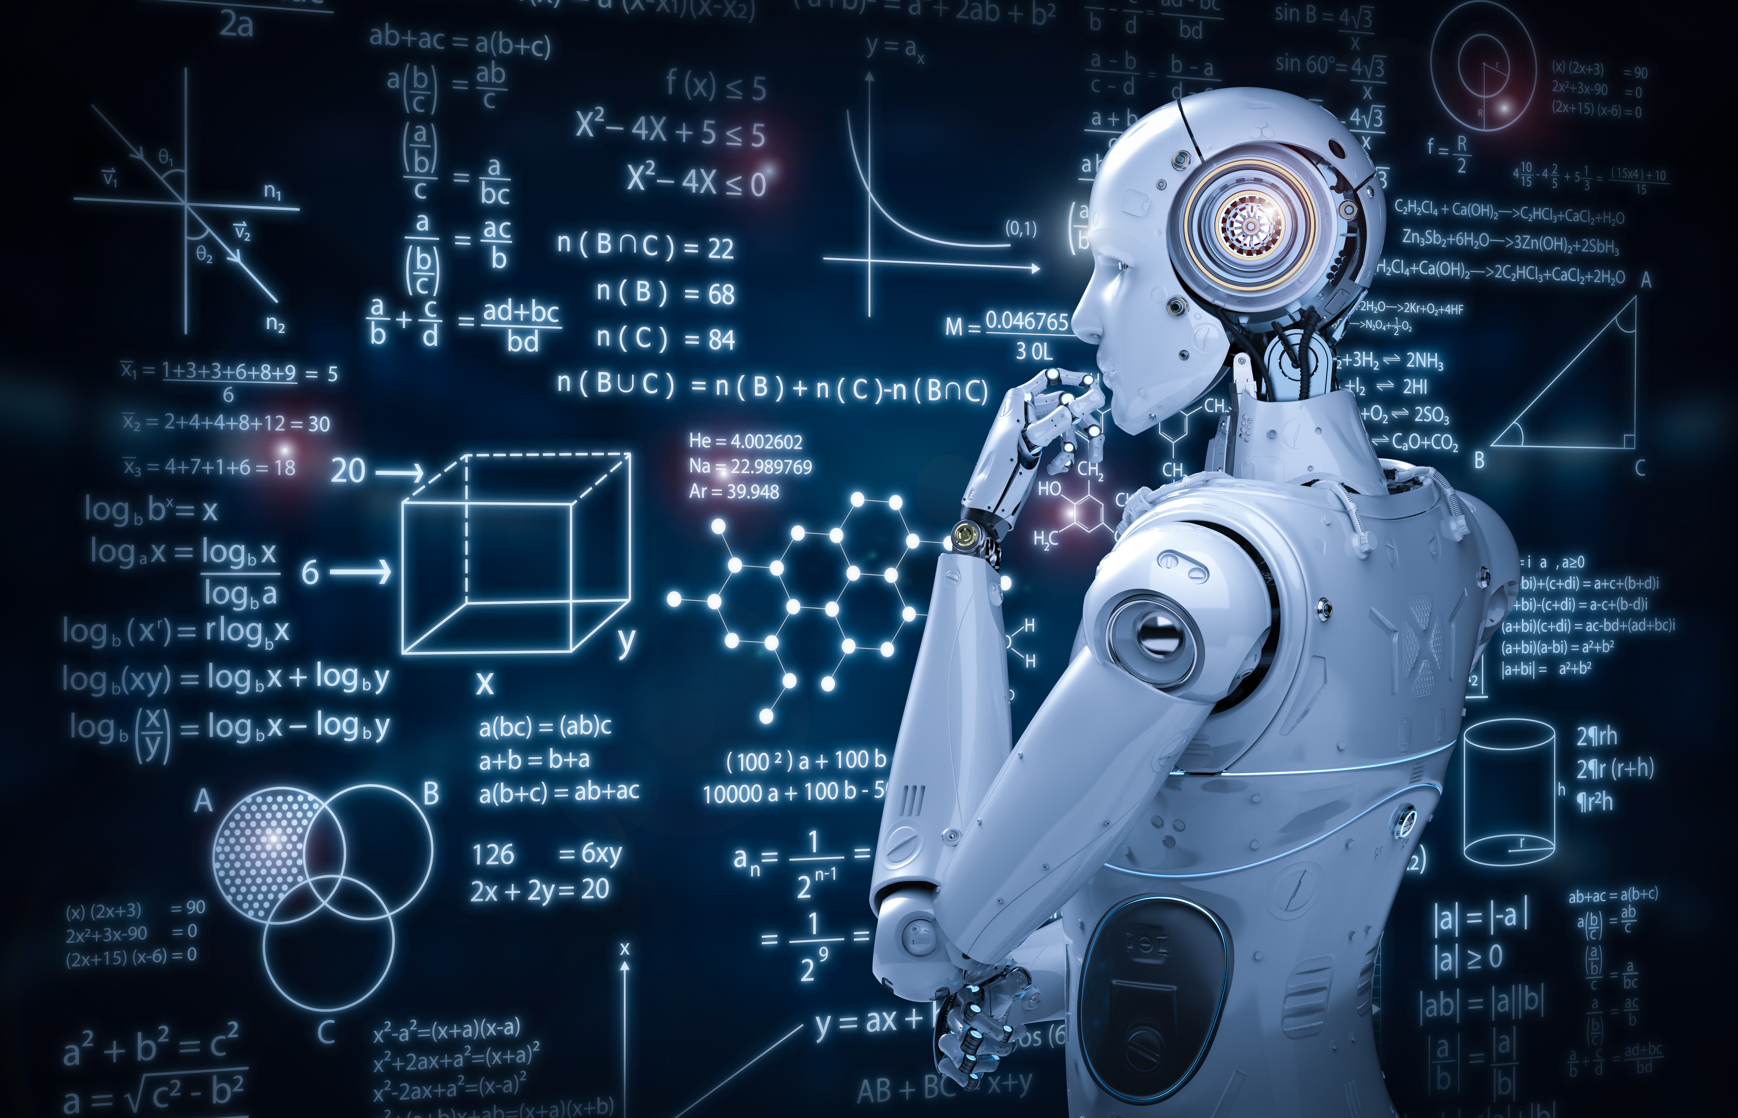
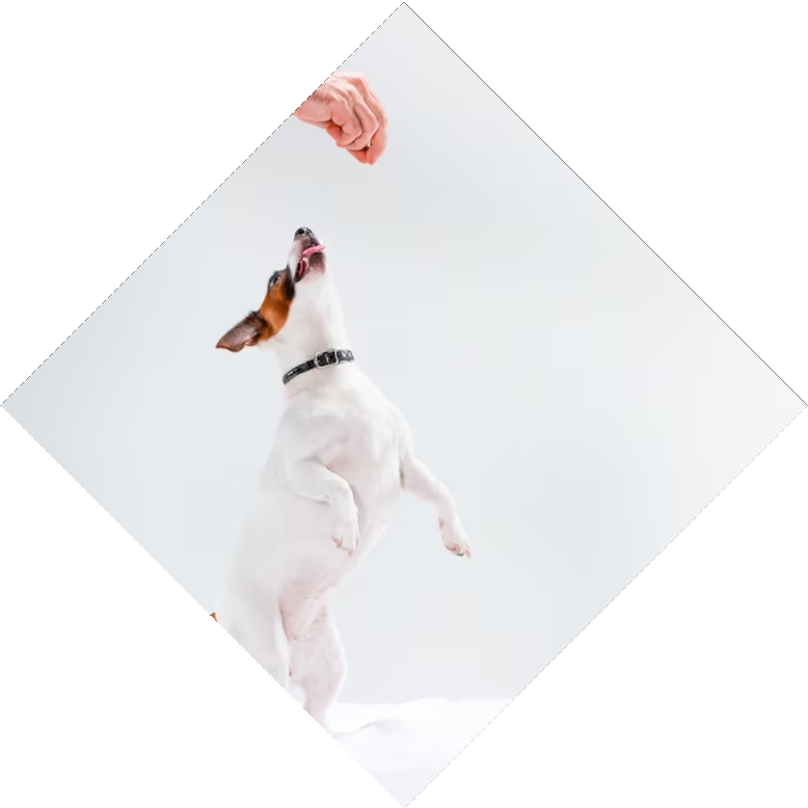
Teach Your Robot to Dance: A Fun Introduction to Reinforcement Learning

Slide 3
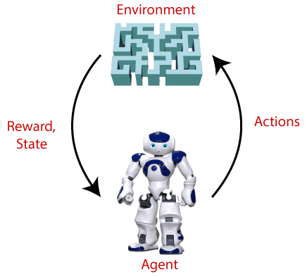
What is Reinforcement Learning?
Reinforcement learning is learning what to do - how to map situations to actions - so as to maximize a numerical reward signal.

Slide 4
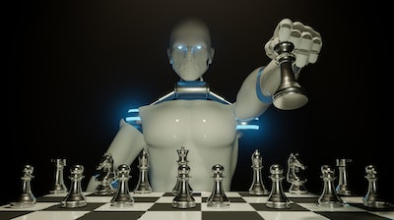
Examples
Master Chess Player
Gazelle Calf
Mobile Robot

Slide 5
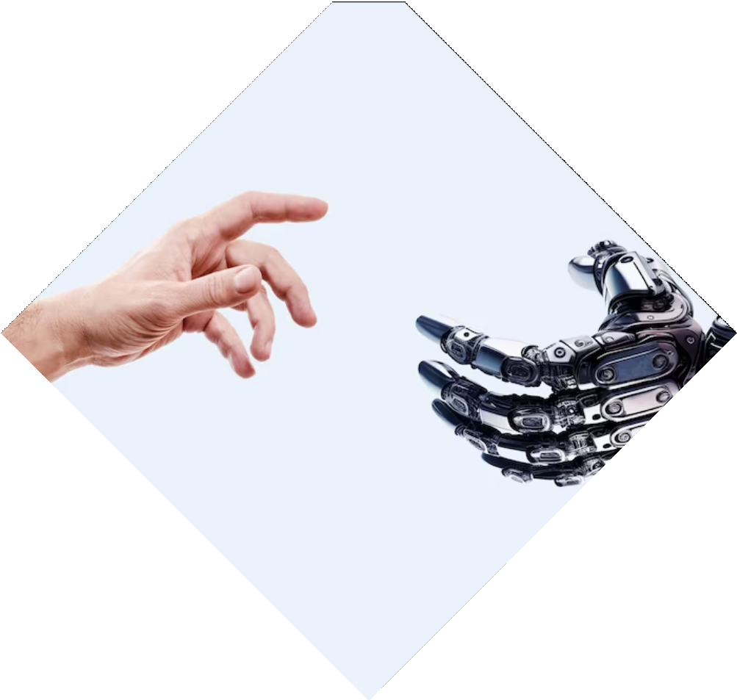
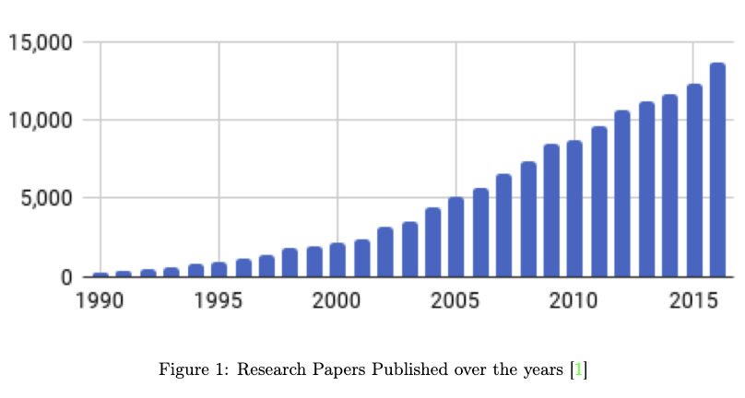
Huge Increase in Interest

Slide 6
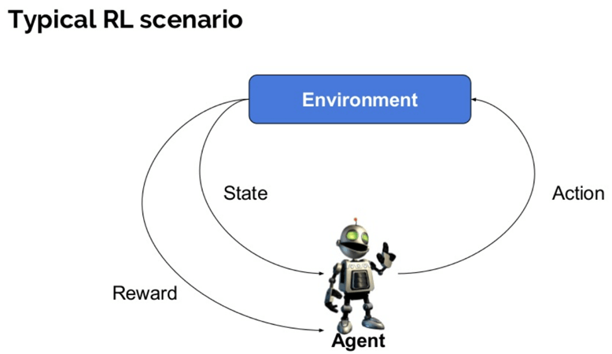
Elements of RL
Policy: Mapping from states to actions.
Reward: Signal that defines the goal of a RL problem.
Value Function: Total amount of reward an agent can expect to accumulate over the future.
Model: Mimics the behaviour of the environment.

Slide 7
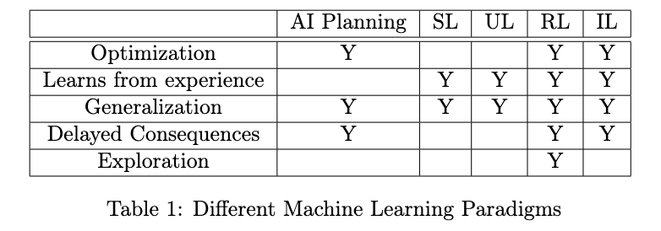
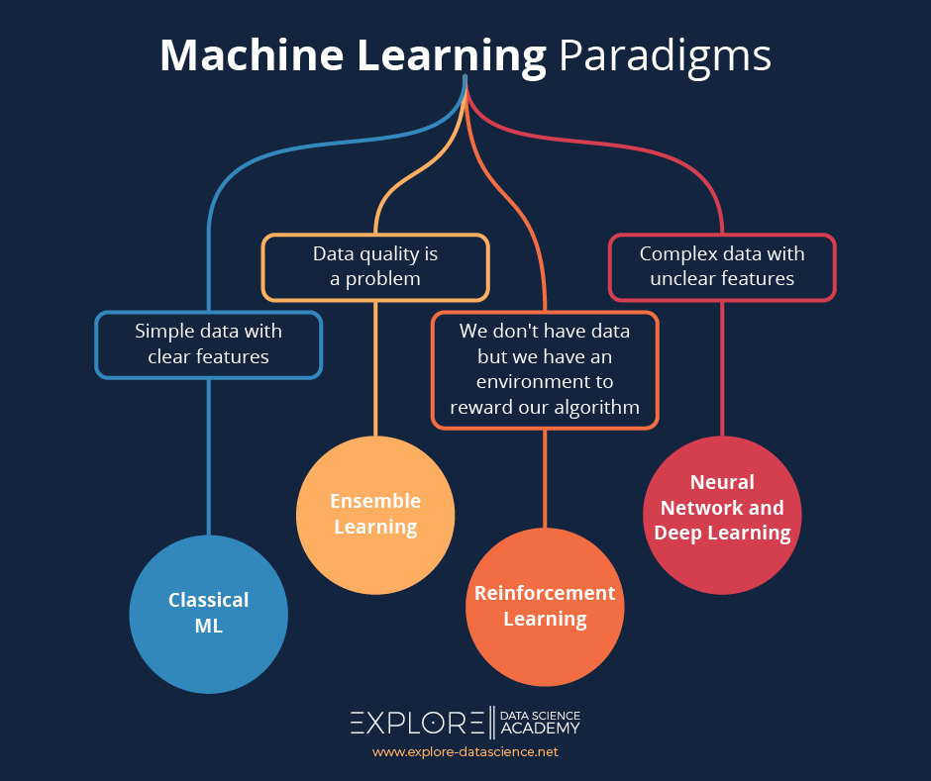
Different Machine Learning Paradigms

Slide 8

Applications of RL
Autonomous Self-Driving Cars
Robotic Surgeons
Customized Recommendation Systems
NLP Applications
Automatic Traffic Light Control System

Slide 9
Thanks
Do you have any questions?
Mail me at: 22b1003@iitb.ac.in
Or contact me on: +91 63756 63539

